Slide 1

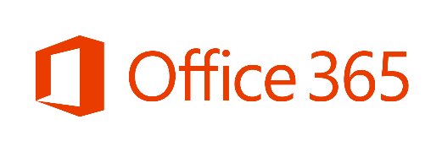
OFFICE 365 ENTERPRISE
E5 LICENSING

Slide 2
LAUNCH ANNOUNCEMENTS
Launch Date | Launch Event
10/1/16 | E5 “Single SKU” in CSP (launched 10/5/16) Secure Productive Enterprise (SPE) – SPE E3 will replace ECS, NEW SPE E5 to be available Office 365 availability will expand to the following markets via EA, Direct, and Open channels: Myanmar, Maldives, Cambodia, Laos, Bhutan, Mozambique, Greenland, Holy See (Vatican City), Martinique and Guadeloupe
9/1/16 | Consumption Billing for PSTN Conferencing and PSTN Calling services PSTN Conferencing services expanded to an additional 17 countries E5 “Single SKU”
7/1/16 | PSTN Calling launched in the United Kingdom PSTN Conferencing Toll-Free Dial-in launched for customers in PSTN Conferencing Sell-to markets
6/1/16 | PSTN Conferencing services expanded to 16 new countries: Argentina, Chile, Colombia, Hungary, Indonesia, Israel, Malaysia, Mexico, New Zealand, Peru, Puerto Rico, Taiwan, Thailand, Turkey, United Arab Emirates and Venezuela Skype for Business PSTN Conferencing and PSTN Calling will be available for Enterprise, Government, and Academic (Enrollment for Education Solutions) customers PSTN Calling launched in Puerto Rico

Slide 3
New Value for Enterprise Customers
SECURITY
Advanced Enterprise Protection
ANALYTICS
Insights for Everyone
VOICE
Complete Cloud Communication
Advanced Threat Protection:
Zero-day threat and malware protection
Advanced Security Management:
Enhanced visibility and control
Customer Lockbox:
Maintain end to end compliance
Advanced eDiscovery:
Identifying the relevant data quickly
Power BI Pro:
Live business analytics and visualization
Delve Analytics:
Individual and team effectiveness
PSTN Conferencing:
Worldwide dial-in for your online meetings
Cloud PBX:
Business phone system in the cloud
PSTN Calling:
Cost effective cloud based dial tone
(add-on)
Notes:
With Office 365 E5, Microsoft delivers its most comprehensive, secure cloud productivity and communications capabilities for enterprise customers.
Provide Enterprise Protection to reduce risk for your enterprise. As part of our people-centric approach to the cloud, we’ve implemented new capabilities as part of the tools you use every day to boost our security, privacy, compliance and transparency commitments. Those capabilities are Advanced Threat Protection, Advanced Security Management, Customer Lockbox, and Advanced eDiscovery.
Deliver Insights for Everyone that help unlock data to help everyone make better decisions. Gain a deeper understanding of your business through Microsoft Analytics solutions. Power BI lets you pull together data from various sources to create simple dashboards and compelling visualizations to make the best business and strategic decisions. Delve Analytics enables your employees to understand where they spend their time and the changes they can make to be more effective and productive at their jobs every day.
Provide Complete Cloud Communication and reduce costs with a single platform for Voice and meetings. You can potentially save millions of dollars by eliminating third-party conferencing and phone charges and PBX maintenance charges by implementing the integrated voice capabilities of Skype for Business, including PSTN Conferencing, Cloud PBX, and PSTN Calling.

Slide 4

Security
Advanced Enterprise Protection
Help protect your organization against unknown malware and viruses (Protect)
Text
Gain enhanced visibility and control into Office 365 usage and security incidents (Detect)
Maintain explicit control over your data in the cloud (Respond)
317 Million
New pieces of malware created in past year*
Maintain compliance while streamlining the eDiscovery process to save time and money
REDUCED RISK
“Safe Attachments in Exchange Online Advanced Threat Protection is going to reduce zero-day threats from malware and viruses. This will help prevent malicious attachments from impacting our environment.”
- Brian Ivie, Chief Security Officer, SunGard
*Symantec “Internet Security Threat Report”, 2015
Notes:
The number of security threats facing organizations is increasing every year. With Office 365 E5, Microsoft offers Advanced Enterprise Protection to reduce risk. We handle your security, so you don’t have to.
Microsoft has a new Security Posture as outlined by Satya Nadella:
Protect your network across all endpoints, from sensors to the datacenter
Detect threats using targeted signals, behavioral monitoring, and machine learning
Respond quickly, closing the gap between discovery and action.
E5 capabilities provide you with even more control with increased privacy, transparency, and refined user controls.
Protect against malware and viruses (Advanced Threat Protection)
Gain enhanced visibility into security (Advanced Security Management)
Maintain control over your data in the cloud even when your service needs to make changes to respond to security incidents (Customer Lockbox)
Simplify eDiscovery (Advanced eDiscovery)
All of these are designed to reduce the risk that your organization faces.
----------------------------------------------------------------------------------------------------------------------------------------------------------------------------------
Data point from Symantec “Internet Security Threat Report”, 2015
http://symantec.postclickmarketing.com/ISTR20?cid=70150000000dkPwAAI
Sungard quote was a part of E5 Launch approved quotes. It is not a part of a customer quote. Please contact Nadine Salem if you have any questions about usage of this quote.

Slide 5
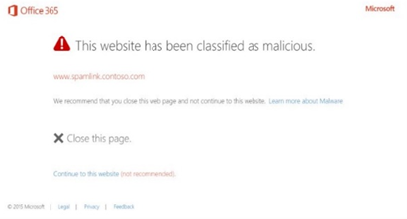
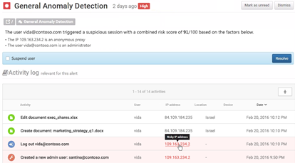
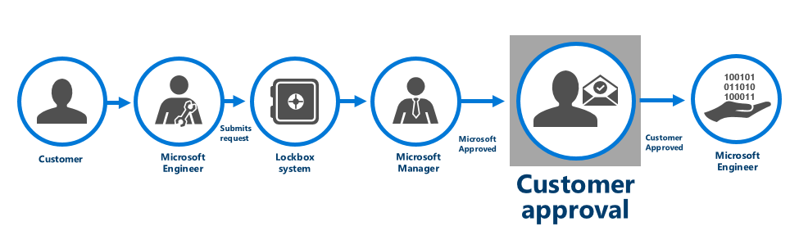
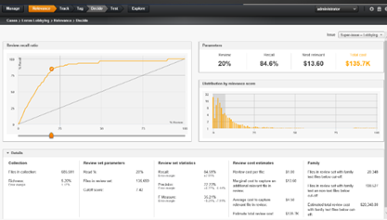
Security
Advanced Threat Protection
Help protect against unknown malware and viruses
Provide real-time, time-of-click protection against malicious URLs
Deliver rich reporting and URL trace capabilities with Click Tracing
Advanced Threat Protection
Advanced Security Management
Identify high-risk and abnormal usage, security incidents, and threats
Gain enhanced visibility and context into Office 365 usage and shadow IT
Reduce the possibility of attacks with granular controls that monitor access
Advanced Security Management
Customer Lockbox
Meet HIPAA & FedRAMP compliance needs with explicit data access procedures
Full access control and oversight provided to customer
Maximize data security and privacy by logging access control activities
Customer Lockbox
Advanced eDiscovery
  Focus on what is unique and relevant by training the system to identify emails and documents through predictive coding
  Reduce document volume with Near Duplicates and Email Threading
Advanced eDiscovery
Notes:
Take a closer look at E5 security and compliance capabilities that continue Microsoft’s deep investments in security
Advanced Threat Protection (ATP)
With Office 365, you gain advanced protection against unknown and sophisticated threats in end-user email, attachments, and URLs. ATP includes three key capabilities:
Safe Attachments protect against unknown malware and viruses by opening documents attached to emails in cordoned-off virtual environments (VM’s) to detect malicious behavior.
Safe Links provide real time, time-of-click protection against malicious URLs by wrapping external links in special URLs that check the destination URL for threats before opening them.
Click Trace provides rich reporting and URL trace capabilities by keeping a record of every user who has clicked on a Safe Link-wrapped URL for additional protection.
Advanced Security Management
With the Advanced Security Management capabilities in Office 365, your security administrators have access to the granular controls and policies they need to monitor access and reduce the possibility of attacks:
Advanced Security Alerts. Admins can use General Anomaly Detection alerts and granular activity policies to react quickly to suspicious activity.
App Permissions enable IT to approve or revoke access for third-party apps or services that users authorize to connect to Office 365.
Cloud App Discovery enables IT to monitor what cloud services users connect to, so they can gain insights, identify anomalies, and manage risky behavior.
Customer Lockbox
Providing security, transparency, and compliance in Office 365 is our top priority. Customer Lockbox for Office 365 can help you meet compliance obligations, such as HIPPA and FedRAMP, by demonstrating that they have procedures in place for explicit data access authorization. In the rare instance when a Microsoft service engineer needs access to your data, you grant that access only to data required to resolve the issue and for a limited amount of time. Additionally, those actions taken by the support engineer are logged for auditing purposes and are accessible via the management Activity API and the Security and Compliance Center.
Advanced eDiscovery
Finally, Office 365 Advanced eDiscovery simplifies the eDiscovery process across your email and document repositories. It leverages machine learning to help you explore large, unstructured sets of data and quickly find what is relevant.
Thread Analysis reconstructs email threads from unstructured data.
Duplicate Detection reduces document volume so you can focus on what is unique.
Predictive coding trains the system to identify relevant email and documents.
Themes and Search help you quickly map unstructured data by using clustering technology to identify data relationships and simplify email reviews.
It’s easy to see why this is the most secure Office ever.

Slide 6

Analytics
Insights for Everyone
Transform your company’s data into rich visuals and analytics for better decision making
Be more effective, make better decisions, and save hours every week with time and relationship insights for individuals and teams
Leader
In Gartner’s Magic Quadrant for
Business Intelligence and Analytics Platforms
for the ninth consecutive year
and placed furthest in vision
BETTER DECISIONS
Focus on what matters to you, so you can make better business strategy decisions as well as personal and team productivity decisions.
“Office 365 has made Henkel faster and more agile.”
-Joachim Jaeckle, Senior CVP, Henkel
*Gartner’s Magic Quadrant for Business Intelligence and Analytics Platforms, February 2016
Notes:
Knowing your business is protected from outside threats gives you the opportunity to focus on what’s going on inside your organization. Microsoft is a leader in business intelligence as its capabilities build upon the world’s most frequently used analysis tool – Excel. Office 365 offers Insights for Everyone and enables you to make more-informed, and better decisions.
-Easy-to-use live data monitoring and in-depth analysis tools in Office 365 let you use your data and unlock stories through simple dashboards, interactive reports, and compelling visualizations. (Power BI)
-And if improving personal and team effectiveness is what you are looking for, Office 365 provides real-time work analytics at the individual level (and soon at the organization level) to optimize activities for the best business outcomes. (Delve Analytics)
Focus on what matters to you so you can make the best business decision possible.
Leader in Gartner’s Magic Quadrant for Business Intelligence and Analytics Platforms, February 2016, for the ninth consecutive year and placed furthest in vision
Leader In Forrester’s Agile Business Intelligence Platforms (Forrester Wave: Agile Business Intelligence Platforms, Q3, 2015)
Henkel case study and video
https://customers.microsoft.com/Pages/CustomerStory.aspx?recid=17982

Slide 7
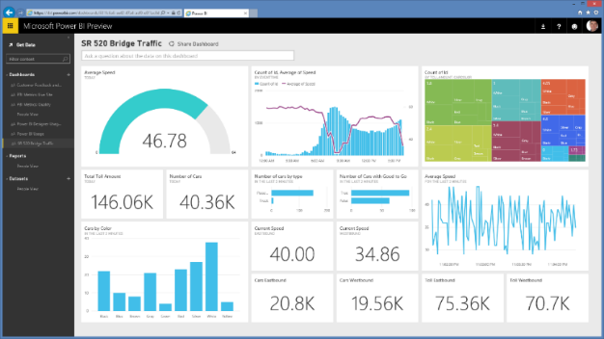
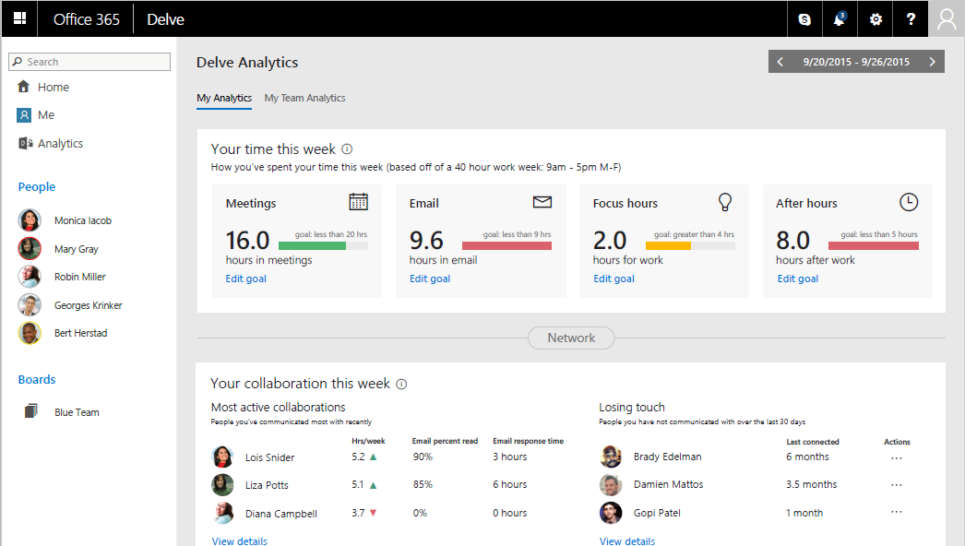
Analytics
Power BI Pro
Gain fast, easy access to the data you need with a simple intuitive experience
Access a live, 360º view of your business through a single dashboard
Discover new insights by exploring your data with rich visualizations
Delve Analytics
Leverage personal analytics to improve individual effectiveness
Use the Outlook add-in to understand email reach and impact
Identify top collaborators and understand collaboration trends
Power BI Pro
Delve Analytics
Notes:
Take a closer look at Analytics capabilities in E5
Power BI transforms your company’s data into rich visuals and analytics, so you can focus on what matters to you. Stay in the know, spot trends as they happen, and push your business further. With Power BI, you can:
Get an end-to-end view off what is happening
Manage multiple data sources
Make the right data available to the right users at the right time
In addition, with out-of-the-box Power BI content packs for popular services such as Salesforce, QuickBooks Online, Marketo, you can create data visualizations in just minutes. You can also publish data from Excel 2016 to Power BI, making it even easier to share data and insights.
Delve Analytics helps you understand time management, business efficiency, and organizational collaboration patterns by using big data and behavioral analytics to reveal how activities drive business outcomes. Everyone from individual employees to team leaders and managers can use Delve Analytics to monitor patterns and find ways to get time back and spend it more effectively.
Delve Analytics Personal Dashboard helps you discover trends for the most important aspects of your day like meetings, email, focus time, and after hours. Use this information to assess how to most effectively rebalance your schedule.
Outlook add-in offers quick feedback about when emails are opened by your colleagues and how many recipients actually read the email you send. Use this information to understand the best time of day to send email and alter content to ensure high read rates. You can also use the email-read analytics to explore read rates, activity trends, and other characteristics of emails that were sent to you.
Email Digest delivers weekly summaries of activity and collaboration characteristics that provide you with simple feedback about time allocation and networking.

Slide 8

Voice
Complete Cloud Communication
Provide one platform for meetings and voice
Reduce voice and conferencing costs
Connect to meetings and each other from virtually anywhere, on any device
100 million
meetings conducted each month
using Skype services
COST SAVINGS
“We estimate that we will save about [US]$100,000 a year by standardizing on Skype for Business Online. This savings results from reducing the use of third-party conferencing providers, long-distance and toll calling contracts, and PBX and phone systems.”
- Niv Dolgin, Director of Enterprise Infrastructure, Ixia
Notes:
At the heart of great teams is great collaboration and communication. That is the core belief that guides our communication investments in Office 365. Teams that communicate often and openly are more efficient, respond faster, plan better and help one another more effectively. They listen to customers and market trends. They share insights with each other. They challenge one another openly. They are great communicators, and that makes them a great team.
E5 investments in Voice support complete cloud communication.
-Microsoft is unique in proving one platform for meetings and voice. Having one platform for meeting and voice gives your teams the ability to communicate easily, using the right tools, from the right devices, and at the right time.
-And that drives significant cost savings. Your employees save time from switching from one system for IM to another one for web conferences, and then to another one for video. With Office 365, everything is integrated into one platform. Your administrators save time because they don’t have to manage multiple products. And your business could potentially save millions by eliminating things like WebEx licenses, ACP per-minute charges, and PBX maintenance costs.
-These capabilities support mobile work and the ability to stay productive from anywhere.
The potential cost savings from these capabilities can be significant for most organizations. Ixia is just one example of a customer saving $100,000 from the use of Skype for Business Online.
------------------------------------------------------------------------------------------------------------------------------------------------------------------------------
Analyst support: Leader in Gartner’s Magic Quadrants for Unified Communications, Corporate Telephony, and Web Conferencing.
Source for over 100 million meetings conducted each month using Skype services
Microsoft, “Expanding the reach of Skype for Business meetings and voice services in Office 365”, 2016
https://blogs.office.com/2016/03/09/expanding-the-reach-of-skype-for-business-meetings-and-voice-services-in-office-365/
Quote from Ixia case study
https://customers.microsoft.com/Pages/CustomerStory.aspx?recid=26528

Slide 9
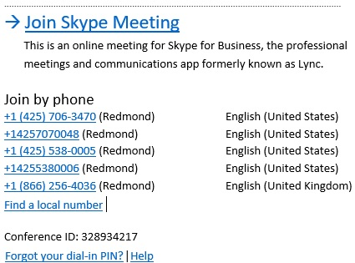
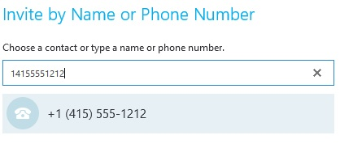
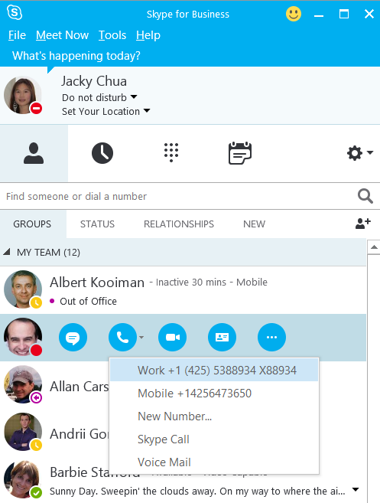
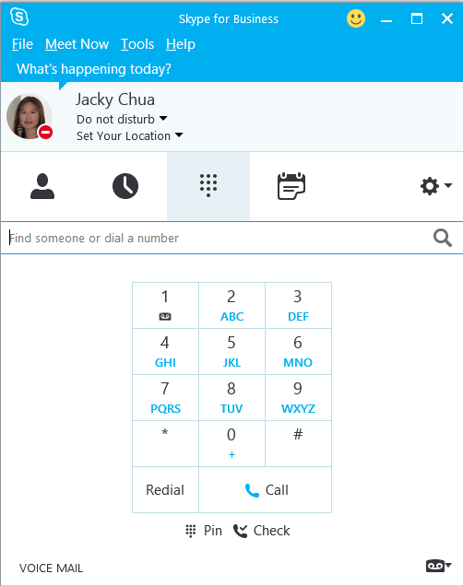
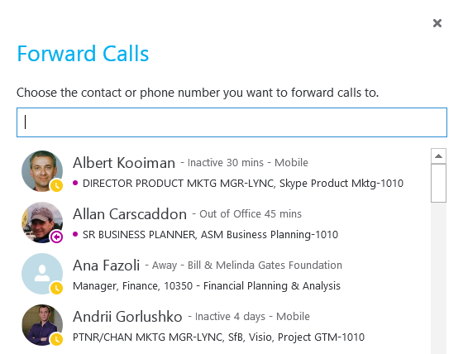
Voice
PSTN Conferencing
Use a tolled dial-in number to join meetings from any device
Dial out to bring participants into the meeting
X
PSTN Conferencing
Cloud PBX
  Centrally manage users for communications, email, and content from Office 365
  Eliminate separate PBX systems and transition to the cloud
PSTN Calling
  Subscribe to calling plans from Office 365
  Use existing phone numbers or get new ones
Cloud PBX
PSTN Calling
Notes:
Skype for Business and Office 365 offer you all the capabilities you need for modern voice and meetings. Audio, video, and web meetings are combined in one connected user experience and platform, with high definition video and a broad range of devices from Microsoft and partners. This helps your business consolidate conferencing solutions and simplify operations while reducing complexity for users, reducing support costs for IT, and enabling employees to work from virtually anywhere.
With PSTN Conferencing, meeting attendees without Internet or audio access on their PCs can dial in to Skype meetings from virtually any device. Meeting organizers can also dial out to attendees and bring them into the meeting. PSTN Conferencing also offers unlimited conferencing as a part of the service, so no charges are incurred for callers using a tolled number to dial-in.
Cloud PBX (when combined with PSTN Calling) is your phone system in the cloud, modern, and tightly integrated with Office 365. Users get the voice capabilities they need—make, receive, and manage calls from anywhere, using any device. (PSTN Calling is required for a true enterprise voice solution.) Cloud PBX also provides great controls for IT to increase agility and consolidate management compared to traditional phone hardware.
PSTN Calling is an add-on to Cloud PBX that provides domestic and international calling services for businesses directly from Office 365. Instead of contracting with a traditional telephony carrier and using an on-premises IP-PBX, you can purchase the Cloud PBX from Microsoft and add on PSTN Calling for a complete enterprise telephony experience for end-users.
--------------------------------------------------------------------------------------------------------------------------------------------------------------------------------------
Differences between E3 and E5
MEETINGS
With E3, you have audio, video, and web conferencing on the Internet
With E3, scales from 2 to 10,000 people
With E3, easy join via smartphone, tablet, PC, Mac, and browser
With E5, PSTN Conferencing adds dial-in numbers around the world for joining by phone when more convenient or when Internet is unavailable.
VOICE
With E3, Person-to-person calling on the Internet
With E3, Reach Skype users in your company and worldwide
With E3, Dial-by-name from Office on smartphone, tablet, PC, Mac
With E5, Cloud PBX adds sophisticated calling features including voice mail, call transfer, admin support, plus option to call traditional phone numbers
Save $5 per user* by enabling Cloud PBX, retiring Cisco or other traditional PBX system (Based on Cisco Call Manager price of $13 per month vs. Cloud PBX at $8)

Slide 10
Office 365 Enterprise Suites
 | E1 | E3 | E5
Features Office 365 Services | $8 | $20 | $35
Business Class Email and Calendars Exchange Online | 50 GB | Unlimited | Unlimited
Social, Video, Sites, Work Management Yammer, O365 Video, SharePoint Online, Planner | ● | ● | ●
IM, Online Meetings, Meeting Broadcast Skype for Business | ● | ● | ●
File Storage, Sharing, Information Discovery OneDrive for Business, Delve | ● | ● | ●
Office Online | ● | ● | ●
Office Client Apps Office 365 ProPlus |  | ● | ●
Archiving, Rights Management, Data Loss Prevention, Encryption |  | ● | ●
Advanced Security Management, Advanced eDiscovery, Secure Attachments and URLs, Access Control |  |  | ●
Analytics Power BI Pro, Delve Analytics |  |  | ●
Cloud PBX Skype for Business |  |  | ●
PSTN Conferencing* Skype for Business |  |  | ●
Enterprise Plan Add-ons
PSTN Domestic and International Calling** Skype for Business |  |  | +$24
CRM Online Professional Dynamics |  | +$50 | +$50
*Toll-free and International Dial-out conferencing capabilities will incur additional per minute consumption charges when available. Customers can disable this feature to avoid additional billing. Limited geo availability.
**Domestic only calling plans are available for $12. Tax is included in price in USA. Add-On price to E1 & E3 is $32, which includes Cloud PBX
Notes:
Now, let’s talk about how all the great new value introduced in the above slides comes together in our Office 365 Enterprise suite offerings including a new premium plan that will deliver the most comprehensive set of productivity, collaboration, analytics, security and compliance capabilities of any Office 365 plan.
First, please orient your attention to the orange highlights on the left side of the table. The orange highlighting denotes features that are new. Here you can see that we have added great differentiating new feature value in E1 and E3 with Skype Meeting Broadcast added into E1, and DLP and Encryption extended across workloads (SfB and SPO) for E3.
We’ve reserved the new advanced feature value of security, analytics and new cloud voice and PSTN conferencing capabilities for E5.
With regard to security, with the acquisition of Equivio we are including analytics for eDiscovery along with Secure Attachments/URLs with Advanced Threat Protection and Access Control or also known as Customer Lockbox.
Machine learning and text analytics with analytic for eDiscovery reduce the costs and risks inherent in managing large quantities of data for eDiscovery
Secure Attachments/URLs allow you to safeguard your organization against unknown threats
Access Control provides unique and unprecedented transparency and customer control over their content in the cloud
On the Analytics front, we are now providing both end user and organizational analytics with Power BI Pro and Delve Analytics.
Power BI Pro enables non-technical users to visualize and analyze data with greater speed, efficiency, and understanding with live dashboards and interactive reports.
Delve Analytics includes a rich interactive dashboard that provides insights into key trends such as reach, influence and work-life balance across an individual and team’s engagement with internal and external teams
Finally, we have features to our communications set of features with Cloud PBX and PSTN Conferencing.
Cloud PBX – enables customers to eliminate separate PBX systems for information workers with the modern requirements for call management delivered directly from Skype for Business.
PSTN Conferencing – allows meeting attendees to dial-in to Skype meetings from virtually any device

Slide 11

E5 Helps Save Costs
$90+
PER USER FROM
COMPETITORS
PBX solution
PSTN conferencing solution
Analytics
$41
PER USER
STANDALONE
The costs of the security products alone justify the incremental E5 suite cost of $15
Cloud PBX
PSTN Conferencing
Delve Analytics
eDiscovery solution
Power BI
$15
PER USER
E5 SUITE DISCOUNT
Office 365 Advanced eDiscovery
E3 Step up to E5
Advanced security
Data access control
Advanced Threat Protection
Advanced visibility
Customer Lockbox
Advanced Security Management
Notes:
This slide has animation and 4 builds
1st build: It would cost you $90 per user per month to get comparable capabilities from non-Microsoft products
2nd build: To purchase the incremental capabilities in E5 as standalone products, the cost would be $41/user/month
3rd build: When purchased as a part of E5, the cost is only $15 (in addition to the costs of E3)
4th build: The cost of just the security products of E5 justify the step up. The standalone costs of these capabilities equal $15
$8 Advanced eDiscovery
$2 Advanced Threat Protection
$2 Customer Lockbox
$3 Advanced Security Management

Slide 12

E5 “SINGLE SKU” WITH PSTN CONFERENCING NOW AVAILABLE
With the E5 “Single SKU”, customers will have an improved purchasing experience by now only having to order a single SKU for $35 which includes everything in E5 including PSTN Conferencing.
Channel Availability
EA Direct, EA Indirect¹
CSP, MPSA, EES/School and Web Direct
GEO Availability
Will be in 65 Countries (see availability slide) ²
The old E5 w/out PSTN Conferencing SKU will be removed from all price lists on 9/1/16 but will stay in lead status in EA Indirect only in US and PR until 7/1/17
In countries where PSTN Conferencing is not available, customers can purchase the new “E5 w/out PSTN Conferencing” SKU for $35
* The $4 PSTN Conferencing Add-on will remain on the pricelists for Skype for Business Plan 2, Business Essentials, Business Premium, E1, and E3 customers.
Notes:
Zone 2.
Partners and Field sellers will position E5 as an offer which includes PSTN Conferencing (where available). When transacting these E5 orders, need to ensure to add both SKUs to the CPS.
While selling the two SKUs together is not technically enforced or enforced on our licensing, we should look to help sell and transact PSTN Conferencing with E5 in the Geos where its possible so we give the customers the best experience.
Another important reason for why we should look to help sell and transact the two SKUs together, is because when we reach the future state, we may not have E5 available without PSTN Conferencing. Having the customers with both SKUs from the beginning will enable an easier transition in to the single E5 with PSTN Conferencing SKU.

Slide 13
E5 “SINGLE SKU” RENEWAL SCENARIOS
Current Licensing SKUs |  |  | New Licensing SKUs
What they have | Current Price |  | New SKU | New Price
E5 + PSTN Conf Add-on | $33 + $2 = $35 | ↑ | E5 (with Conf)* | $35
E5 only (PSTN Conferencing Sell-to Market) | $33 | ↑
E5 only (PSTN Conferencing Non Sell-To Market) | $33 | ↑ | E5 w/o PSTN Conf* | $35
Due to the complexity of some transition scenarios, the old E5 and PSTN Add-on SKUs will remain available temporarily in some channels:
 | $33 E5 w/o PSTN SKU | $2 PSTN Add-on SKU
Channel | Available through
EA/EES/School Indirect (US, PR) Lead Status | 7/1/2017 | 7/1/2017
CSP/Open/Syndication* | 7/1/2017 | - -
*The New E5 SKUs for $35 will not be available in Open. Geoblocking will be used to enforce the transaction of E5 (with Conferencing) in all Sell-to markets and the transaction of E5 w/o PSTN Conferencing in Non Sell-to markets
For detailed transition information visit the E5 and SfB Licensing FAQ

Slide 14

NEW LICENSING MODEL - STEP UPS FOR ADD-ONS
HIGHLIGHTS
8 new Step-up Add-on SKUs:
  For E3->E5 and E4->E5
  For CoreCal vs. ECAL
  For Device vs. User Licensing
Price is calculated as the difference between two SKUs
E5 Add-on
$13
$11.30
Step Up to E5 Add-on
Step Up to E5 Add-on
E3 Add-on
E4 Add-on

Slide 15
PATHS TO E5
E5
$15
$13
Step Up to E5
Step Up to E5
E3/ECS
E4

Slide 16
PATHS TO CLOUD VOICE FOR E4
Full IT & End User Value
E5
Cloud PBX and PSTN Conferencing
Advanced Security and Compliance
End User and Organizational Analytics
+$13
Voice in the Cloud
E3
Cloud PBX
+$6
E4
$22
On-Prem PBX
Prices reflect the incremental cost of customers transitioning from E4 to either E3 with Cloud PBX or E5
E4 customers can also maintain current licensing position by having E3 + On-Prem PBX
E4 will remain on the Price List until June 30th, 2016 after which point it will be available as Lead Status only

Slide 17
SCENARIO SUMMARY
Current Licensing Position |  |  | End State Licensing Position
What they have | Current Price |  | What they want | New SKUs | New Price*
E4 | $22 E4 | ↑ | E5 | E5 Step up SKU | +$13 E5 Step up
E3 | $20 E3 | ↑ | E5 | E5 Step up SKU | +$15 E5 Step up
E3 | $20 E3 | ↑ | E3 with Cloud PBX | Cloud PBX Add on | +$8 Cloud PBX
E3 Plus CAL | $20 E3 $2 Plus CAL | ↑ | E5 | E5 Step up SKU | +$13 E5 Step up
ECS | $20 E3 | ↑ | ECS with E5 | E5 Step up SKU | +$15 E5 Step up
ECS with E4 | $20 E3 $2 Voice Add on | ↑ | ECS with E5 | E5 Step up SKU | +$13 E5 Step up
*New Price is in addition to what customers are currently paying for existing O365 SKUs that they are upgrading from

Slide 18
OFFICE 365 SERVICES PRICING
 | Pre-Reqs | E5 | E1/E3 | Business Essentials or Business Premium | Price
Advanced Threat Protection | Exchange Online | Included | Add-on | Add-on | $2
Customer Lockbox | Exchange Online or SharePoint Online | Included | Add-on | Add-on | $2
Delve Analytics | Exchange Online | Included | Add-on | Add-on | $4
Power BI Pro | None | Included | Add-on | Add-on | $10
Equivio Analytics for eDiscovery | Exchange Online or SharePoint Online | Included | Add-on | Add-on | $8
Cloud PBX | Skype for Business Online Plan 2 | Included | Add-on | N/A | $8
PSTN Conferencing | Skype for Business Online Plan 2 | Included | Add-on | Add-on | $4
PSTN Calling (US Only) | Skype for Business Online Plan 2 + Cloud PBX | Add-on | Add-on Cloud PBX Required | N/A | $12/$24
*Dial-out conferencing capabilities may incur additional per minute consumption charges. Customers can disable these features to avoid additional billing.
**$24 includes both International and Domestic calling plans. Domestic only calling plans are available for $12. Tax is included in price in the US. Service usage limits exist to manage fraud, abuse, excessive use, and maintain service performance. Further details about these services can be found in our recently published Skype for Business Online PSTN Service Use Terms.

Slide 19
PSTN SERVICES AVAILABILITY
Available for Commercial, EDU, Government¹, and Non-Profit
PSTN Conferencing
Licensing Platform
Sell-To Countries
Included Dial Out Countries
Pay as You Go Dial Out Countries
EA Direct
EA Indirect
MOSP
CSP
EES/School
MPSA
Open⁴
Australia
Austria
Belgium
Brazil²
Bulgaria
Canada
Croatia²
Czech Republic
Denmark
Estonia
Finland
France
Germany
Greece
Hungary
Ireland
Italy
Japan
Luxembourg
Malaysia
Mexico
Netherlands
New Zealand
Norway
Poland
Portugal
Puerto Rico⁵
Romania
Russia
Singapore
Slovak Republic
Slovenia
South Africa²
South Korea
Spain
Sweden
Switzerland
Taiwan
Thailand
United Kingdom
United States
Argentina
Bosnia & Herzegovina
Chile
Colombia
Costa Rica
Dominican Republic
Egypt
Indonesia³
Israel
Latvia
Lithuania
Malta
Monaco
Peru
Philippines
Qatar
Serbia
Sri Lanka
Turkey
UAE³
Ukraine
Uruguay
Venezuela³
Vietnam
For Provisioning and Dial In Availability by Market visit the PSTN Conferencing Support page
For language availability visit the Skype for Business International Availability page
CSP
EES/School
MPSA
United States
United Kingdom
Puerto Rico⁵
PSTN
Calling
EA Direct
EA Indirect
MOSP
For more details on PSTN Services, see the Skype for Business PSTN Services Overview deck
PSTN Consumption
EA Direct MOSP
EA Indirect EES/School
Available in all PSTN Conferencing Sell-To countries except: Australia, Brazil, Croatia, Russia, South Korea, Taiwan
¹Conferencing is launching as standalone on 9/1/2016. Full E5 still unavailable.
² EA Direct channel unavailable in Brazil & Croatia, CSP Channel unavailable in South Africa
³ No toll free dial-in access numbers in Venezuela, Indonesia & UAE
⁴ Open includes OLP, OV, OVS, and OVS-ES
⁵ All PSTN services, including E5 Single SKU unavailable in Web Direct on 9/1/16. PSTN Calling in VL EA/EES Direct/Indirect only.

Slide 20
PSTN SERVICE PLANS OVERVIEW THROUGH 2/1/17
Introductory Offer Period
 | PSTN Conferencing |  | PSTN Calling
 | Included Dial Out Countries | Pay as you Go Dial Out Countries | Domestic Plan $12 u/m | Domestic + International Plan $24 u/m
Included in Service Plan | Inbound Conferencing Dial Out Conferencing to Included Dial Out Countries (Domestic Dial Out Included) | Inbound Conferencing Dial Out Conferencing to Included Dial Out Countries (Domestic Dial Out Excluded) | Inbound calling Domestic outbound calling* | Inbound calling Domestic outbound calling* International outbound calling*
PSTN Consumption Required (per minute usage) | Toll Free Dial-in Conferencing Dial Out Conferencing to PAYG Dial Out Countries | Toll Free Dial-in Conferencing Dial Out Conferencing to PAYG Dial Out Countries | International outbound calling Excessive usage** | Excessive usage**
Consumption Scenarios | A user dials out to a user in a PAYG country - usage charged by the minute |  | A user needs to call an international number. They can use PSTN Consumption to pay per minute | Customer reaches either minute limit but needs to make more Domestic or International calls. All overages charged by the minute.
*See PSTN Calling minute limits
** Minutes will be pooled at the tenant-level for each plan type. For all local and international calls placed to users within the same tenant, Peer to Peer calling will be enabled and the call will be placed over the voice over IP network and will not count towards the excessive use limits.
Note: Education pricing differs from commercial.
For more details on PSTN Services, see the Skype for Business PSTN Services Overview deck
Notes:
Purpose of this slide is to highlight the multiple PSTN Services offers and identify key differences.
PSTN Conferencing:
This is the offer that comes in E5.
Included in the USL are unlimited incoming calls to the dial-in number provided and Unlimited domestic dial-out calls (domestic = to calls within the country of the user initiating the conference.)
Pre-requisite is Skype for Business Online Plan 2 (included in all E suites)
PSTN Calling:
Two plans: one Domestic Only and one Domestic + International
See slide 15 for excessive minute caps per plan
This service is not included in E5 but sold as a separate product
Pre-requisites for this calling plans are Cloud PBX and Skype for Business Plan 2 (both included in E5 but also available for E3, E1 customers
Both plans include unlimited inbound minutes
Point out that there are two separate plans and walk through key differences (Int’l calling) i.e. minutes included in each plan (slide 15)
Then walk through scenarios, especially bottom right scenario regarding minute limits being reached
PSTN Consumption offer enhances calling plans and conferencing with highlighted features

Slide 21
PSTN SERVICE PLANS OVERVIEW POST 2/1/17
 | PSTN Conferencing |  | PSTN Calling
 | Included Dial Out Countries | Pay as you Go Dial Out Countries | Domestic Plan $12 u/m | Domestic + International Plan $24 u/m
Included in Service Plan | Inbound Conferencing Domestic Dial Out Conferencing | Inbound Conferencing | Inbound calling Domestic outbound calling* | Inbound calling Domestic outbound calling* International outbound calling*
PSTN Consumption Required (per minute usage) | Toll Free Dial-in Conferencing International Dial Out Conferencing | Toll Free Dial In Conferencing Domestic Dial Out Conferencing International Dial Out Conferencing | International outbound calling Excessive usage** | Excessive usage**
Consumption Scenarios | A user dials out to a user in a different country - usage charged by the minute | A user dials out to a user in a different country or their own country - usage charged by the minute | A user needs to call an international number. They can use PSTN Consumption to pay per minute | Customer reaches either minute limit but needs to make more Domestic or International calls. All overages charged by the minute.
*See PSTN Calling minute limits
** Minutes will be pooled at the tenant-level for each plan type. For all local and international calls placed to users within the same tenant, Peer to Peer calling will be enabled and the call will be placed over the voice over IP network and will not count towards the excessive use limits.
Note: Education pricing differs from commercial.
For more details on PSTN Services, see the Skype for Business PSTN Services Overview deck
Notes:
Purpose of this slide is to highlight the multiple PSTN Services offers and identify key differences.
PSTN Conferencing:
This is the offer that comes in E5.
Included in the USL are unlimited incoming calls to the dial-in number provided and Unlimited domestic dial-out calls (domestic = to calls within the country of the user initiating the conference.)
Pre-requisite is Skype for Business Online Plan 2 (included in all E suites)
PSTN Calling:
Two plans: one Domestic Only and one Domestic + International
See slide 15 for excessive minute caps per plan
This service is not included in E5 but sold as a separate product
Pre-requisites for this calling plans are Cloud PBX and Skype for Business Plan 2 (both included in E5 but also available for E3, E1 customers
Both plans include unlimited inbound minutes
Point out that there are two separate plans and walk through key differences (Int’l calling) i.e. minutes included in each plan (slide 15)
Then walk through scenarios, especially bottom right scenario regarding minute limits being reached
PSTN Consumption offer enhances calling plans and conferencing with highlighted features

Slide 22
PSTN CONFERENCING INVOICE BREAKOUT %
Office 365 E5 and Secure Product Enterprise E5 are bundled offers that include PSTN Conferencing. There can be tax implications based on how these offers are presented on an invoice. For indirect channels, we recommend that partners contact their legal and tax departments for further assistance.
Percentage breakout of PSTN Conferencing portion of bundled offers
Impacted SKUs with PSTN Conferencing | % Invoice Breakout for PSTN Conferencing
Office 365 E5 USL | 5.71%
Office 365 E5 From SA | 5.71%
Office 365 E5 Add-Ons | 5.71%
Office 365 E5 Step Up from Office 365 E1 | 7.41%
Office 365 E5 Step Up from Office 365 E3 | 13.33%
Office 365 E5 Step Up from Office 365 E4 | 15.38%
Secure Productive Enterprise E5 | 3.51%
Applies to EA, MPSA, CSP and EDU
Notes:
Purpose of this slide is to highlight the multiple PSTN Services offers and identify key differences.
PSTN Conferencing:
This is the offer that comes in E5.
Included in the USL are unlimited incoming calls to the dial-in number provided and Unlimited domestic dial-out calls (domestic = to calls within the country of the user initiating the conference.)
Pre-requisite is Skype for Business Online Plan 2 (included in all E suites)
PSTN Calling:
Two plans: one Domestic Only and one Domestic + International
See slide 15 for excessive minute caps per plan
This service is not included in E5 but sold as a separate product
Pre-requisites for this calling plans are Cloud PBX and Skype for Business Plan 2 (both included in E5 but also available for E3, E1 customers
Both plans include unlimited inbound minutes
Point out that there are two separate plans and walk through key differences (Int’l calling) i.e. minutes included in each plan (slide 15)
Then walk through scenarios, especially bottom right scenario regarding minute limits being reached
PSTN Consumption offer enhances calling plans and conferencing with highlighted features

Slide 23
SKYPE FOR BUSINESS SERVER RIGHTS
E5 and Cloud PBX customers will be able to connect their existing PSTN service provider with Microsoft’s cloud-based call control.
Scenarios are based on whether a customer already has a Skype for Business Server deployed
Existing Server
No Existing Server
Customers with an existing Skype for Business Server deployment can configure it to connect to Cloud PBX functionality
Covered under existing Server licensing
Customer can leverage a minimal Skype for Business Server deployment
Four preconfigured Virtual Machines are deployed on customer owned Windows Servers
Skype for Business Server roles in VMs are not paid roles and are licensed for use with Cloud PBX

Slide 24

© 2015 Microsoft Corporation. All rights reserved. Microsoft, Windows, and other product names are or may be registered trademarks and/or trademarks in the U.S. and/or other countries.
The information herein is for informational purposes only and represents the current view of Microsoft Corporation as of the date of this presentation. Because Microsoft must respond to changing market conditions, it should not be interpreted to be a commitment on the part of Microsoft, and Microsoft cannot guarantee the accuracy of any information provided after the date of this presentation. MICROSOFT MAKES NO WARRANTIES, EXPRESS, IMPLIED OR STATUTORY, AS TO THE INFORMATION IN THIS PRESENTATION.

